Slide 1
Object oriented programming
Iván Guerrero Román

Slide 2
Session #18
Today’s topics
5. Graphical user interface (GUI)
a. Simple components to implement a GUI

Slide 3
Java FX

Slide 4
Java FX
JavaFX provides a complete API with a rich set of classes and interfaces to build GUI applications with rich graphics.
In JavaFX, the GUI Applications were coded using a Scene Graph. A Scene Graph is the starting point of the construction of the GUI Application. It holds the (GUI) application primitives that are termed as nodes.
A node is a visual/graphical object and it may include −
Geometrical (Graphical) objects − (2D and 3D) such as circle, rectangle, polygon, etc.
UI controls − such as Button, Checkbox, Choice box, Text Area, etc.
Containers − (layout panes) such as Border Pane, Grid Pane, Flow Pane, etc.
Media elements − such as audio, video and image objects.

Slide 5
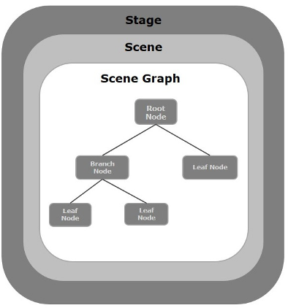
Stage
A stage (a window) contains all the objects of a JavaFX application. It is represented by Stage class of the package javafx.stage.
Scene
A scene represents the physical contents of a JavaFX application. It contains all the contents of a scene graph. The class Scene of the package javafx.scene represents the scene object.

Slide 6
Application
The Application class of the package javafx.application is the entry point of the application in JavaFX. To create a JavaFX application, you need to inherit this class and implement its abstract method start(). In this method, you need to write the entire code for the JavaFX graphics
In the main method, you have to launch the application using the launch()method.

Slide 7
Hello world app
import javafx.application.Application;
import javafx.stage.Stage;
import javafx.scene.Scene;
import javafx.scene.Group;
public class HelloWorldFx extends Application {
public void start(Stage stage) throws Exception {
stage.setTitle("Hello world");
Group root = new Group();
Scene scene = new Scene(root);
stage.setScene(scene);
stage.show();
}
public static void main(String args[]){
launch(args);
}
}

Slide 8
Controls

Slide 9
Controls
Every user interface considers the following three main aspects −
UI elements − These are the core visual elements which the user eventually sees and interacts with.
Layouts − They define how UI elements should be organized on the screen and provide a final look and feel to the GUI (Graphical User Interface).
Behavior − These are events which occur when the user interacts with UI elements.

Slide 10
Common controls
JavaFX provides several classes in the package javafx.scene.control to create various GUI components (controls).
Label
A Label object is a component for placing text.
Button
This class creates a labeled button.
CheckBox
A CheckBox is a graphical component that can be in either an on(true) or off (false) state.
ListView
A ListView component presents the user with a scrolling list of text items.
TextField
A TextField object is a text component that allows for the editing of a single line of text

Slide 11
Common layouts
Layout panes (classes) provided by JavaFX exist in the package javafx.scene.layout.
HBox
The HBox layout arranges all the nodes in our application in a single horizontal row.
VBox
The VBox layout arranges all the nodes in our application in a single vertical column.
BorderPane
The Border Pane layout arranges the nodes in our application in top, left, right, bottom and center positions.

Slide 12
StackPane
The stack pane layout arranges the nodes in our application on top of another just like in a stack. The node added first is placed at the bottom of the stack and the next node is placed on top of it.
GridPane
The Grid Pane layout arranges the nodes in our application as a grid of rows and columns. This layout comes handy while creating forms using JavaFX.
FlowPane
The flow pane layout wraps all the nodes in a flow. A horizontal flow pane wraps the elements of the pane at its height, while a vertical flow pane wraps the elements at its width.

Slide 13
Information resources
JavaFX API
https://docs.oracle.com/javase/8/javafx/api/toc.htm
JavaFX Tutorial
https://www.tutorialspoint.com/javafx/index.htm

Slide 14
Session #18
Today’s topics
5. Graphical user interface (GUI)
a. Simple components to implement a GUI

